Slide 1
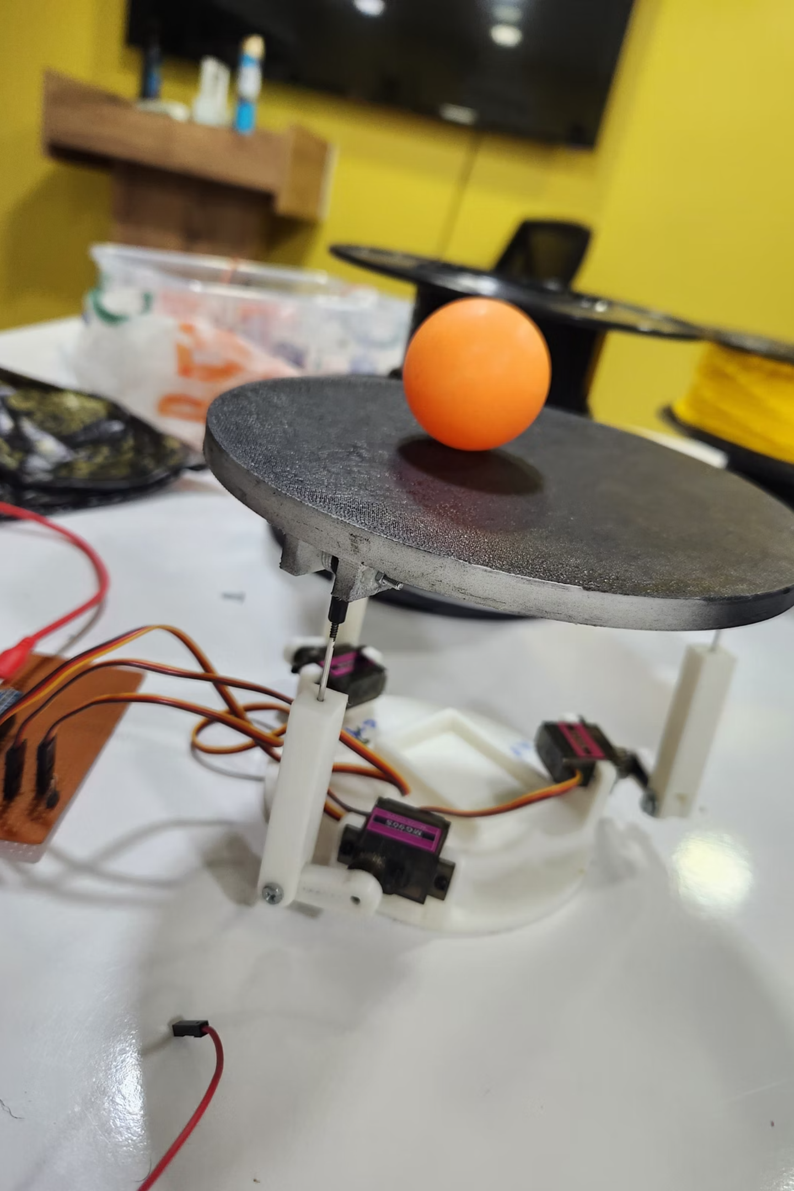
Real-Time Ball-Balancing Robot
Project: real-time ball-balancing robot using camera + STM32 + 3-leg RRS platform.
Goal: keep an orange ball centered on a circular platform by tilting it with three servos.
Main components: camera + OpenCV, Python sender, STM32 controller, PID loop, inverse kinematics, 3R-R-S mechanical legs.

Slide 2
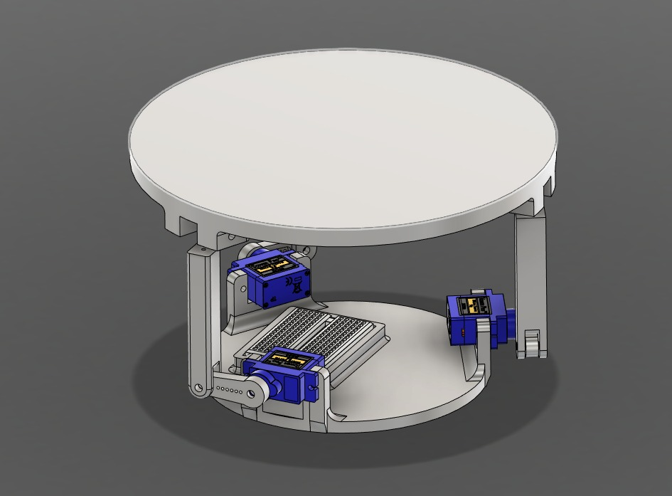
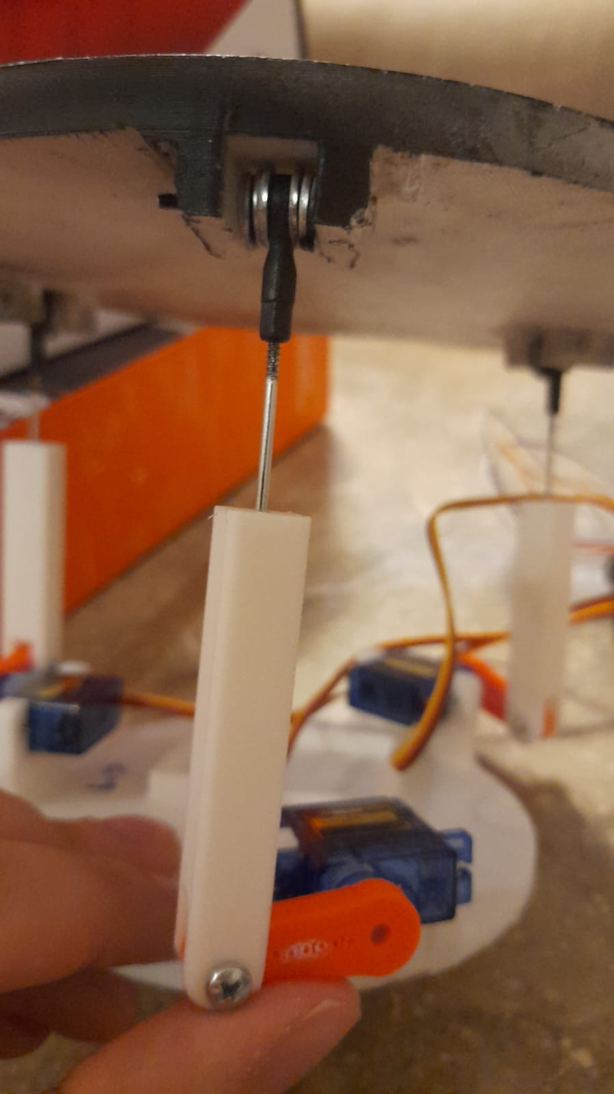

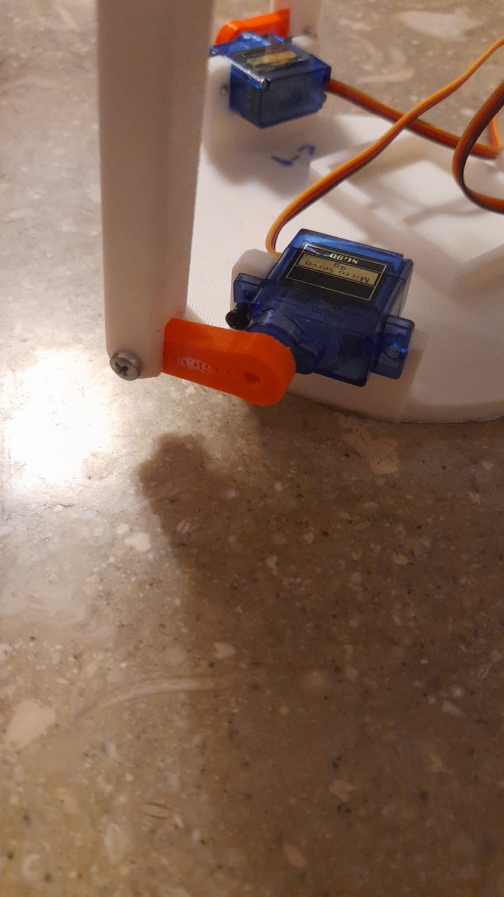
Mechanical Design
R-R-S Topology
Mechanism type: R-R-S topology (two revolute joints + spherical joint at the moving platform).
Figure0: The design of the system
Leg Configuration
Each leg: base revolute actuated by a servo → link → spherical joint to the platform.
Platform Design
Platform: circular plate where ball rolls; base triangle provides three actuation points.
Design Goals
Key design goals: stiffness, safe servo travel (servoMin=40 to servoMax=120), and known neutral geometry for IK.
Figure1: revolute joint
Figure2: revolute & spherical joints

Slide 3
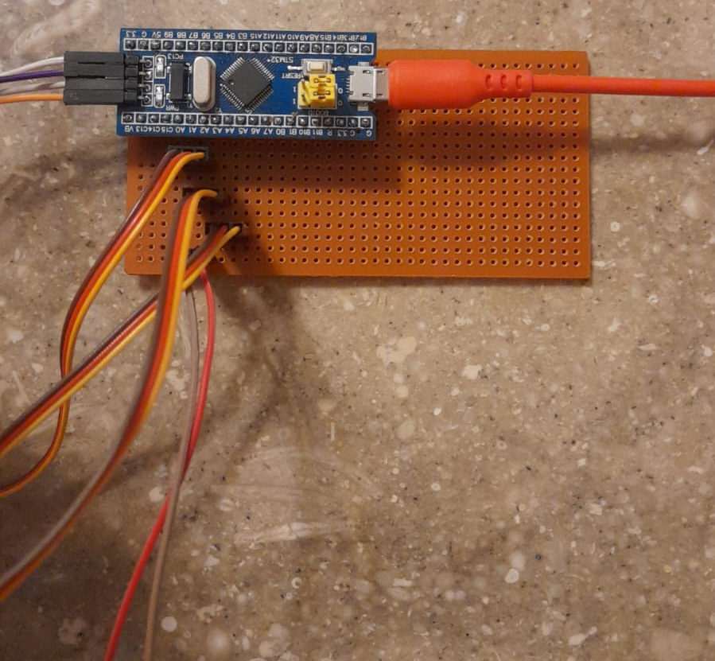
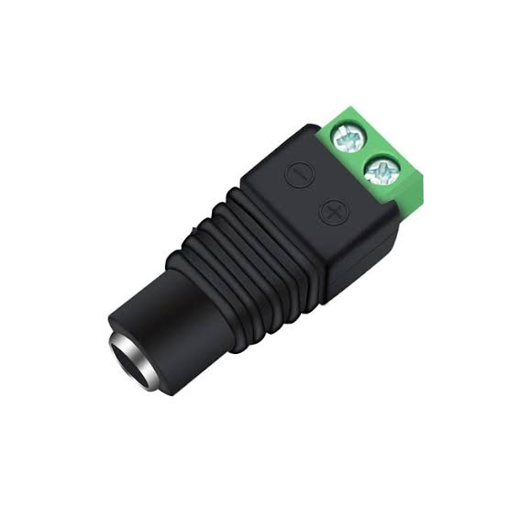
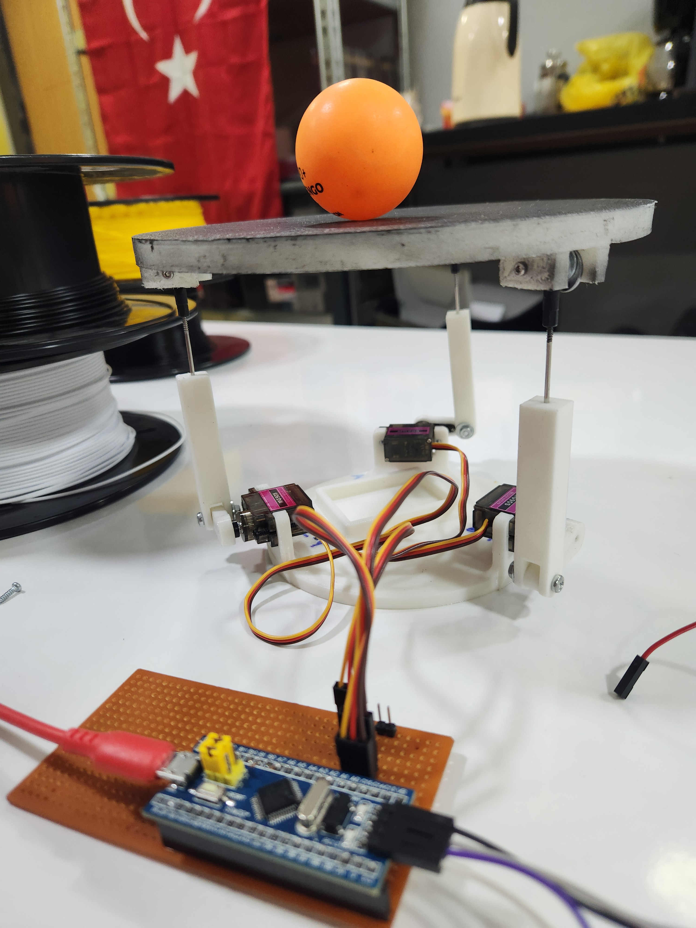
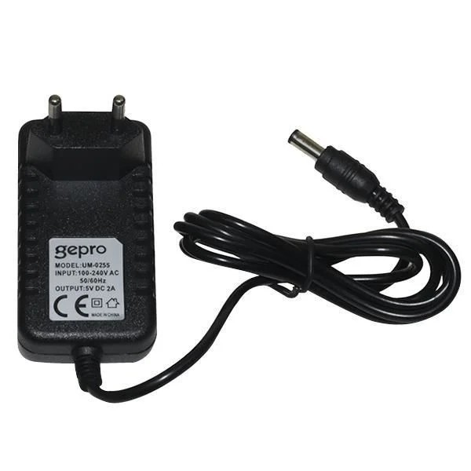
Hardware Implementation
Custom PCB
Power System
Custom PCB for signal & power routing.
Servos powered by an external 5 V adapter
Figure3: Final PCB
Figure4: Final PCB with the system
Figure5: Power supply adapters

Slide 4
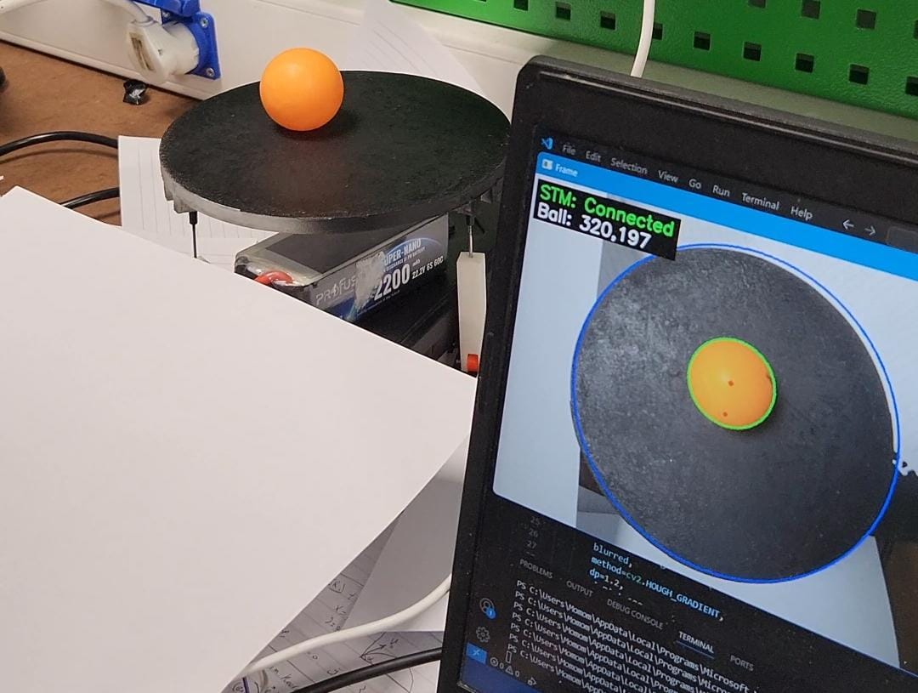
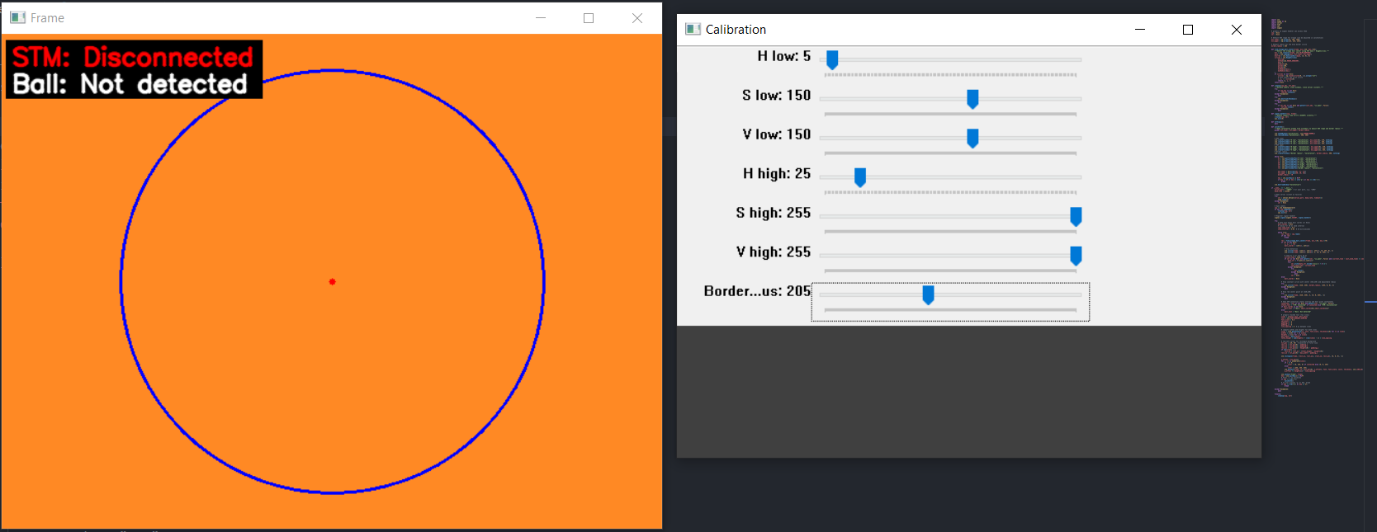
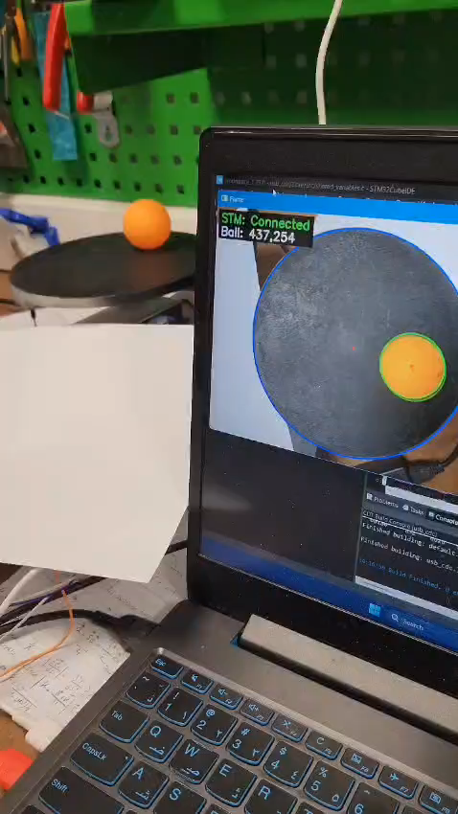
Figure7: real time calibration window
Figure6: photo of the final algorithm
Computer Vision System
Figure8: Video of the final algorithm
01
02
Color Detection
Shape Detection
Color detection: convert frame to HSV, apply HSV range (default hsv_lower=[5,150,150], hsv_upper=[25,255,255]) to isolate orange pixels.
Shape detection: blur mask (Gaussian 9×9) then use HoughCircles (dp=1.2, param1=100, param2=15, minRadius≈55–70) to find circular ball contour → returns (x,y,r).
03
04
Visualization & Calibration
Data Transmission
Visualization & calibration: draw a constant blue border circle at (320,240) with adjustable border_radius (default 205) and a red center point at (320,240) to align camera pixels with the physical platform circle.
Data transmission: when ball found, Python sends "x,y\n" over serial at up to 50 Hz (send interval 0.02 s). If not connected, the overlay shows "STM: Disconnected".

Slide 5




STM and Serial Communication
Serial Link
Data Format
Parsing
Serial link: Python → STM32 over UART (example Python port COM23, baud 115200).
Sent format: simple ASCII "x,y\n" (parser also accepts (x,y)), STM32 reads line-by-line.
Parsing: STM32 trims newline, extracts x and y as floating values and updates lastSerialTime.
Status & fail-safe: if no serial updates for >500 ms, STM32 returns platform to flat (0,0). Also Python shows connection status overlay.

Slide 6
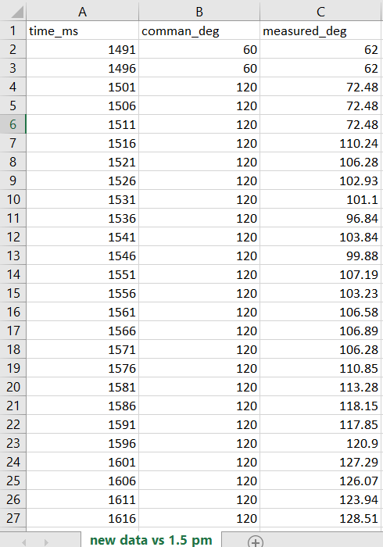
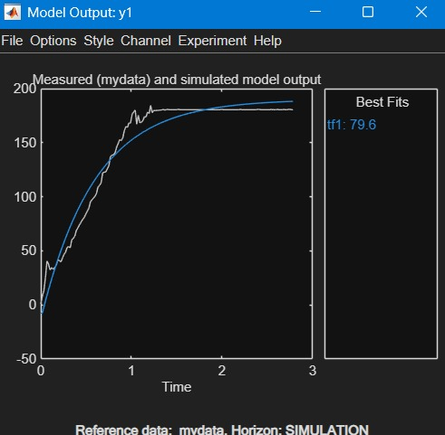
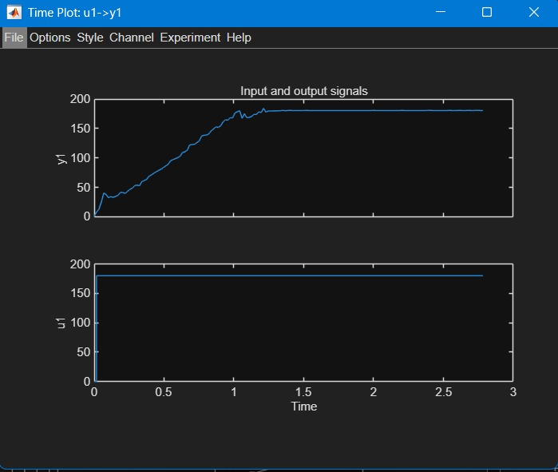
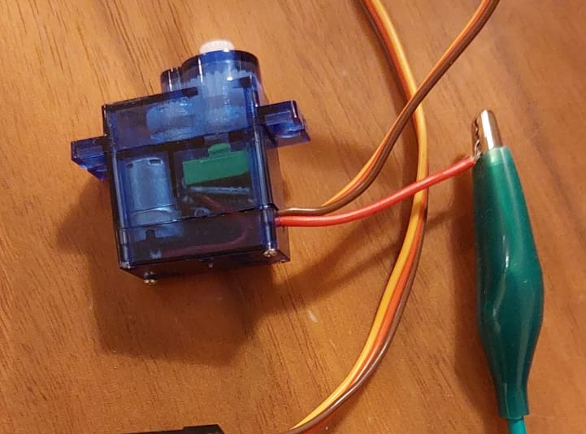
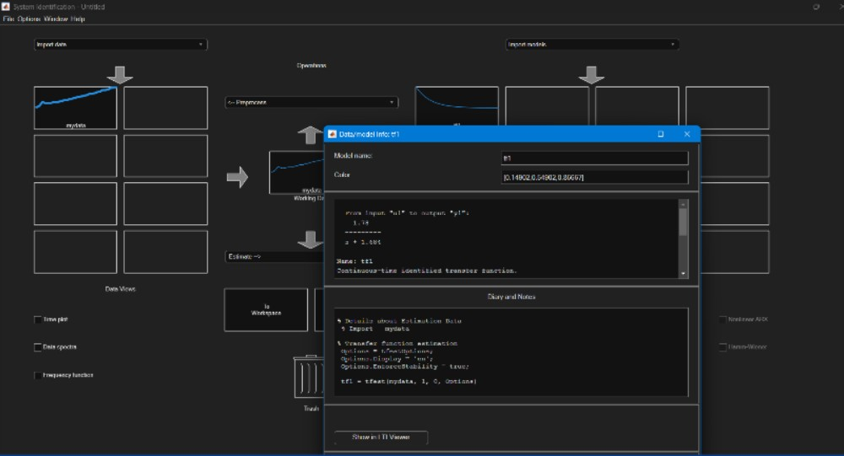
SYSTEM MODILING
Figure9: Servo abu_daneb
Figure11: Fitting the servo graph
Figure12: Fitting the servo graph
Figure10: Data has been collected
Collecting Data
Data Format
using ID tools
Using the encoder built-in the Servo
Time in ms, command in deg,, and measured deg from the encoder
Obtained the TS of the servo sing the black box method
Figure13: TS function of the servo

Slide 7
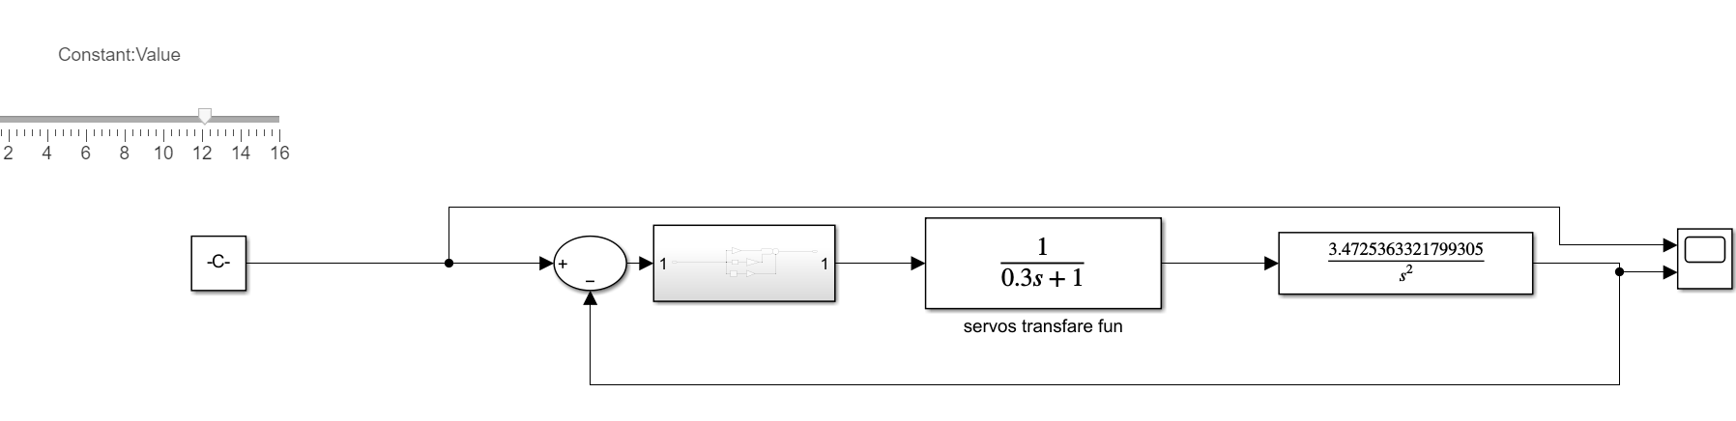
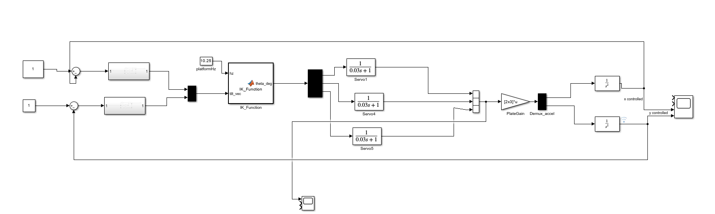
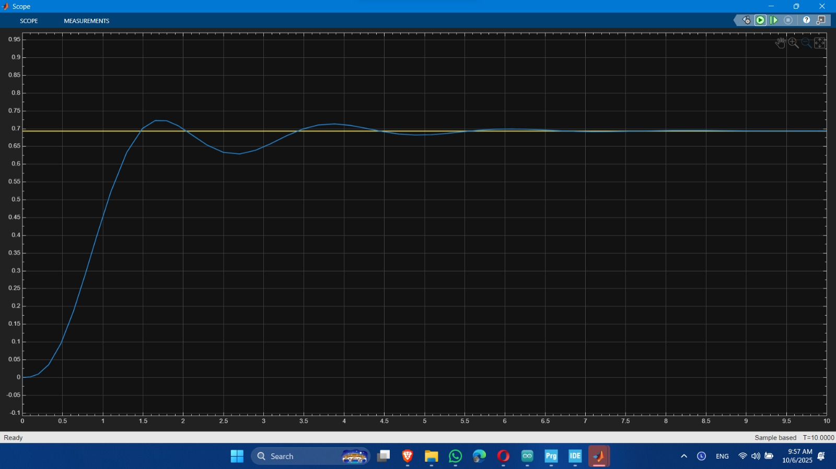
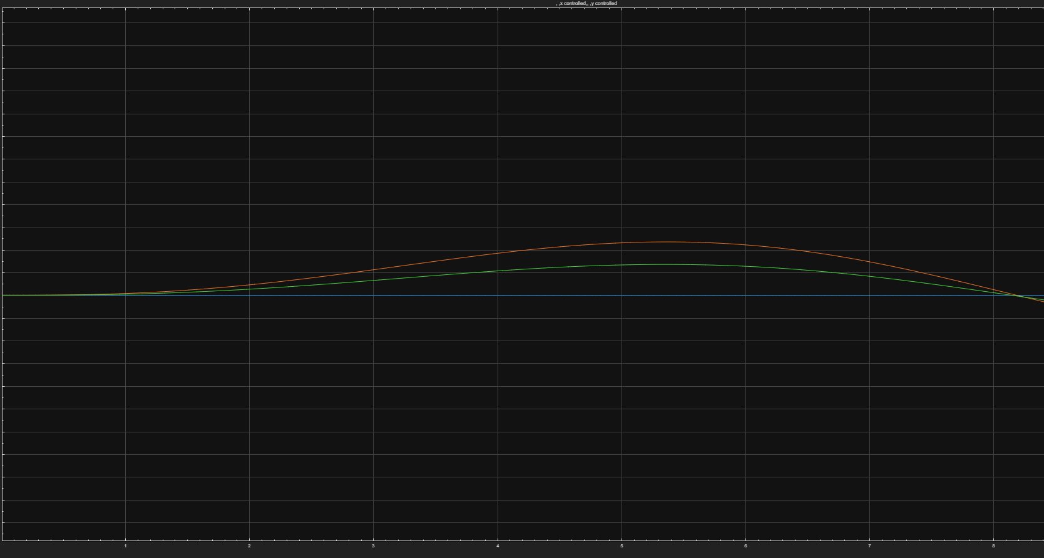
SYSTEM MODILING and Simulink
Figure14: Simulink file without IK
Figure16: the Simulink of the final system
Figure15: scope of figure 14 system
Figure17: scope of figure 16 system

Slide 8
PID Control System
Pixel Error Definition
Pixel error definition: error = center - ball_pixel where centerX=320, centerY=240.
PID Implementation
PID implementation (discrete, sample time LOOP_PERIOD_MS = 20 ms):
integr += (err + err_prev) * dt (trapezoidal integration)
deriv = (err - err_prev) / dt
out = kp*err + ki*integr + kd*deriv
Control Parameters
Safety Constraints
Gains used in code: kp = 0.00030, ki = 0.0, kd = 0.00020 (units: output slope per pixel).
Saturation & safety: PID outputs are constrained to [-maxSlope, +maxSlope] with maxSlope = 0.9 to limit platform tilt.
Control loop: if new sample available, compute PID and call moveTo(platformHz, -out_x, -out_y) at 50 Hz.

Slide 9
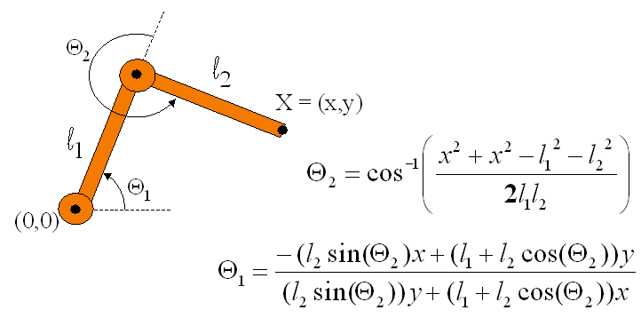
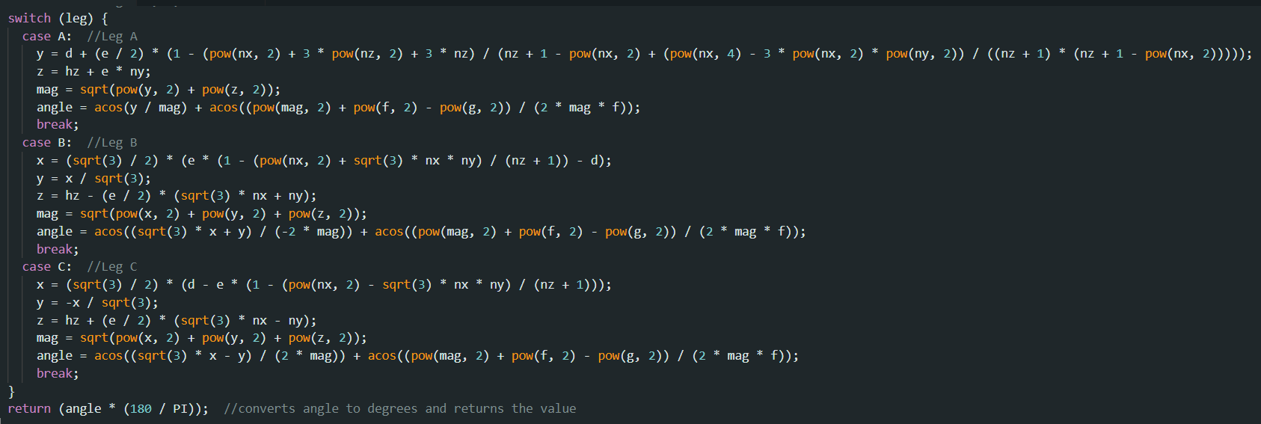
Figure18: simple explanation of the IK
Inverse Kinematics
Figure19: IK final equations
Definition
Implementation
Servo Mapping
What is IK: algorithm that converts desired platform pose (height + tilt slopes) into required actuator joint angles for each leg.
In our implementation: we use machine.theta(legIndex, hz, nx, ny) which returns the required theta for each leg given platform height platformHz and slopes (nx, ny).
From theta → servo angle: servoAngle = servoNeutral + servoSign * round(theta - theta0) where theta0 is baseline flat theta.
Control Flow
Safety & mapping: resulting servo angles are constrained to safe travel [servoMin, servoMax] and then written to servos.
Overall flow: pixel coords → PID → slopes (nx,ny) → IK (thetaA,B,C) → servo angles → actuation.

